Slide 1
Health and
Safety Culture:
Motivation and Influence
AIHce 2011
Marianne Levitsky
Om Malik
ECOH Management, Inc.
www.ecoh.ca www.healthandsafetycatalyst.com

Slide 2
Who Are We?
Om Malik: CEO of ECOH Management, Inc., Toronto
Marianne Levitsky: Senior Industrial Hygienist, ECOH Management, Inc.
Both previously senior management, Ontario Ministry of Labour/Workplace Safety and Insurance Board

Slide 3
Overview: How can OHS professionals influence Health and Safety Culture?
Review: What is health and safety culture?
How Can We Assess It?
How Can We Influence It?
  Whom do we need to influence?
  Motivation
Interventions: what works?
Slides will be available on www.healthandsafetycatalyst.com

Slide 4

Perspective
Experience in safety culture research and social marketing
Skeptical enthusiasm: no silver bullets
Focus on how OHS professionals can influence their organizations
Cross-pollinator: what can we learn from other disciplines?

Slide 5
Review: What is Health and Safety Culture?

Slide 6
Safety Culture Is Viewed As An Aspect Of Organizational Culture
“…the basic values, norms, beliefs, and practices that characterize the functioning of a particular institution…defines the assumptions that employees make as they carry out their work…a powerful force that persists through reorganizations and the departure of key personnel.”
Columbia Accident Investigation Board

Slide 7
“SHARED values, attitudes and beliefs that shape health and safety practice”
Beliefs
Culture
Practices
Values, Attitude
Head
Heart
Culture
Hand

Slide 8
Also described as…
“The way we do things around here”
“What the workers do when the boss isn’t around”

Slide 9
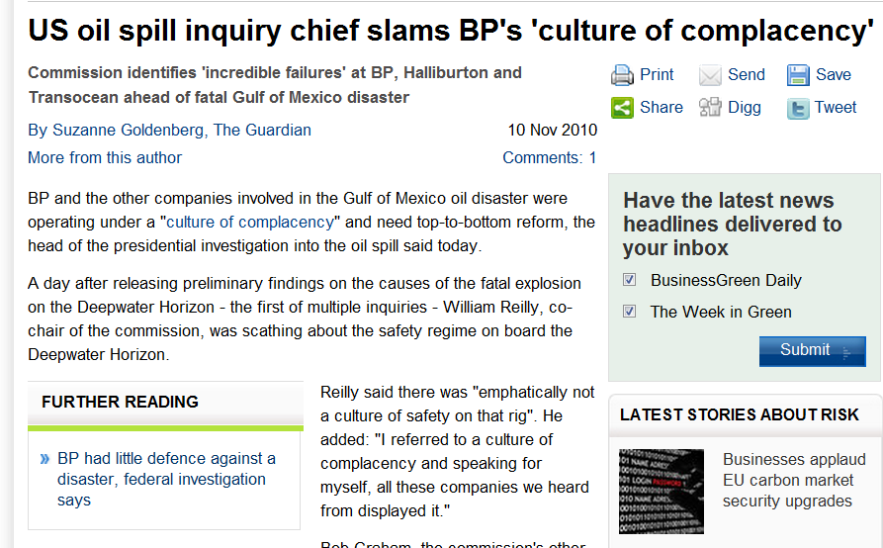
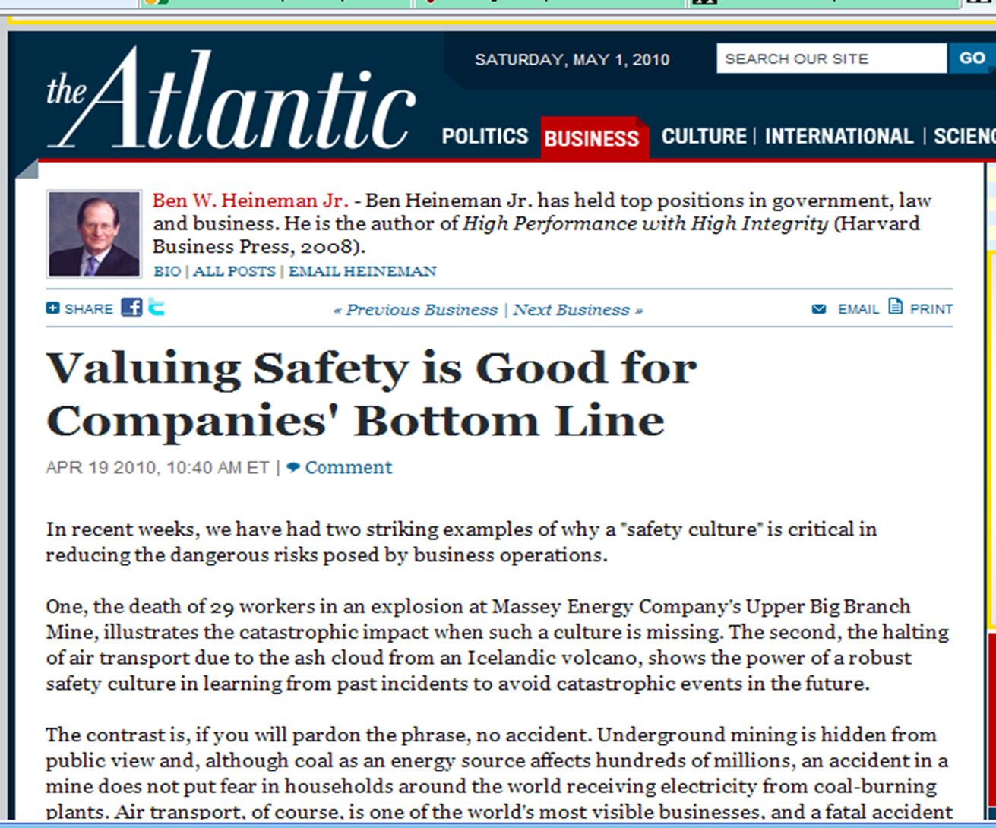
Commonly invoked as a general explanation for why people do what they do

Slide 10
So if you’re not the CEO, how do you influence health and safety culture?
Assess and Diagnose
Motivate and Influence

Slide 11
Assess and Diagnose

Slide 12
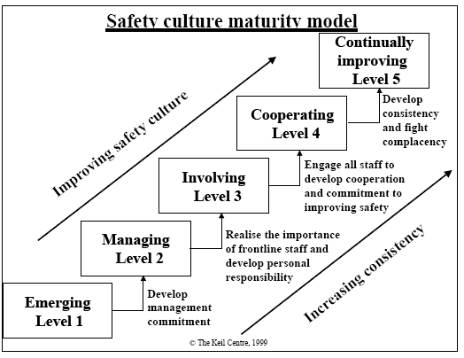
UK HSE Safety Culture Maturity Model
Compliance-based; safety not seen as a key business activity, safety department seen as responsible for OHS
12

Slide 13
UK HSE Safety Culture Maturity Model
Procedure-based, reactive, injuries perceived to be caused by worker behavior
13

Slide 14
UK HSE Safety Culture Maturity Model
Increasing engagement of staff, management acceptance of responsibility for H&S
14

Slide 15

UK HSE Safety Culture Maturity Model
Increasing engagement of staff, management acceptance of responsibility for H&S
The leap between Level 2 and Level 3 from a rule-based to an engagement-based mindset
15

Slide 16
Assessing safety culture: How predictive are safety climate surveys?
Antonsen: Safety Culture Assessment: A Mission Impossible?
After a disaster, one can always find safety culture problems

Slide 17
A Word of Advice
Do your own assessment of management commitment and your organization’s maturity before planning any surveys
Don’t undertake any formal evaluations or safety climate surveys unless there is genuine management commitment to act on the findings.
See www.healthandsafetycatalyst.com for links to free assessment tools.

Slide 18
Assessing Safety Culture: Indicators
Safe behavior and conditions
H&S Management System
Demonstrated management commitment, e.g.
  Visible caring and involvement
  Safety on meeting agendas
  Safe practices are rewarded even when they affect productivity
  No mixed messages, finger pointing
Incident, near miss reporting and investigations
Importance of safety in performance reviews
Employee participation
Number of conversations about safety
  Especially between supervisors and workers

Slide 19
Influencing Safety Culture as an OHS Professional

Slide 20
Interventions to motivate and influence
Work with the existing culture not against it
Intervention must be appropriate to the maturity stage
Prioritize whom to influence
  Top Management?
  Supervisors?
  Workers?

Slide 21
Continuum of Interventions
Unaware Low barriers Motivation | Some barriers Motivation | Entrenched High barriers No motivation
Information | Social motivation | Law

Slide 22

Decision Making/Motivation Theory:
Traditional Economics:
Choices driven by rational calculation of costs and benefits
“Economics traditionally conceptualizes a world populated by calculating, unemotional maximizers that have been dubbed Homo Economicus”
(Thaler and Mullainathan)
If this were true, health and safety would be intrinsically motivating

Slide 23

Decision Making/Motivation Theory:
Traditional Economics
Behavioural Economics
Choices driven by rational calculation of costs and benefits
“Economics traditionally conceptualizes a world populated by calculating, unemotional maximizers that have been dubbed Homo Economicus”
(Thaler and Mullainathan)
If this were true, health and safety would be intrinsically motivating

Slide 24
Behavioural Economics
The combination of psychology and economics that investigates what happens in markets in which some of the agents display human limitations and complications.
(Thaler and Mullainathan)

Slide 25


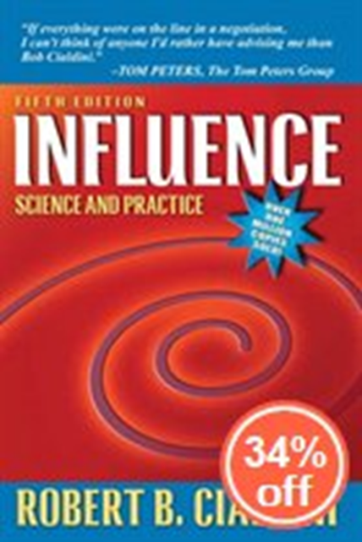


Popularizers of Behavioral Economics and Decision Influencers

Slide 26
Research findings on motivation and decision-making (“human limitations and complications”)
Incentives
Loss aversion
Feedback
Now or later?
Description-Experience Gap
Social norms - Relationships
Commitment and Ownership
Habit – Attention – Mindfulness
How can we use these to influence health and safety?

Slide 27


Carrots and sticks: what works?
Recent writers about errors in common thinking about incentives
  Barry Schwartz, Practical Wisdom
  Daniel Pink, Drive
People are motivated by
  Pink: Mastery, Purpose, Autonomy
  Other people
  Recognition
  Morals and values
  Intrinsic challenges

Slide 28
Incentives: The Daycare Study*
Daycare problem: parents picking up their kids late.
To try to correct this problem, the centers imposed a fine for late pick-ups.
Result?
The rate of late pick-ups tripled!
When the fines were discontinued, the rate of late pick-ups stayed high.
Why?
Converted a moral motivator to an economic motivator
*The description of this study was popularized in Freakonomics and cited hundreds of times since then. Some have questioned the conclusions, claiming that the monetary incentive would have worked if it were higher.

Slide 29
Imagine that you are a public health official preparing for the outbreak of an unusual disease expected to kill 600 people.
Choose a program to address the problem.
Program A: 200 people will be saved
Program B: 1/3 chance that 600 people will be saved. 2/3 chance that no people will be saved.
This and next 4 slides adapted from Professor U. Roy, Long Island University

Slide 30
Imagine that you are a public health official preparing for the outbreak of an unusual disease expected to kill 600 people.
Choose a program to address the problem.
Program A: 400 people will die.
Program B: 1/3 chance that nobody will die. 2/3 chance that 600 people will die.

Slide 31

Imagine that the US is preparing for the outbreak of an unusual disease, which is expected to kill 600 people.
Choose a program to address the problem.
72%
A: 200 people will be saved
B: 1/3 chance that 600 people will be saved. 2/3 chance that no people will be saved.
28%
Tversky, A. & Kahneman, D., 1981, The framing of decisions and the psychology of choice. Science, 211, 453-458.

Slide 32

Imagine that the US is preparing for the outbreak of an unusual disease which is expected to kill 600 people.
Choose a program to address the problem.
A: 400 people will die.
B: 1/3 chance that nobody will die. 2/3 chance that 600 people will die.
22%
78%
Tversky, A. & Kahneman, D., 1981, The framing of decisions and the psychology of choice. Science, 211, 453-458.

Slide 33
Framing and Loss Aversion
The psychological principles that govern the perception of decision problems and the evaluation of probabilities and outcomes produce predictable shifts of preference when the same problem is framed in different ways.
Tversky, A. & Kahneman, D., 1981, The framing of decisions and the psychology of choice. Science, 211, 453-458.
http://psych.hanover.edu/classes/cognition/papers/tversky81.pdf

Slide 34
Framing and Loss aversion
Reframing the same option as a loss changes the choices.
The pain of losing something is 2x the pleasure of gaining it.

Slide 35

What does this mean for financial H&S motivators?
Beware of converting a moral motivator to a financial motivator
Loss-aversion: are penalties better motivators than rewards?
Research results on financial incentives to employers for H&S are mixed:
  Tompa: reduce severity but not frequency
  Economic incentives as a policy tool to promote safety and health at work. Kankaanpää E. Concludes that incentives do not directly lead to improvement.
Scand J Work Environ Health. 2010 Jun;36(4):319-24. Epub 2010 Jun 2.
BUT… financial and legal motivators can change a delayed, rare outcome into an immediate outcome

Slide 36
Now or Later?
Would you rather I gave you
$200 now or $300 tomorrow?
$200 now or $300 in six months?
Something we have in common with….

Slide 37

Now or Later?
Would you rather I gave you
$200 now or $300 tomorrow?
$200 now or $300 in six months?
Something we have in common with….
Ian Ayres: www.stickk.com

Slide 38
People tend to:
Underweight delayed outcomes
Underweight or overweight rare outcomes

Slide 39
What determines whether we underweight or overweight rare events? The Description-Experience Gap
Overweighting occurs when people decide on the basis of description
  Buy lottery tickets and insurance
Underweighting occurs when they decide on the basis of experience (feedback), especially recent feedback
  “It won’t happen to me”

Slide 40
Can we counteract this tendency through
  Descriptions of outcomes?
  Feedback?
    Increase frequency of feedback (outcomes)
    Change delayed to immediate outcomes

Slide 41
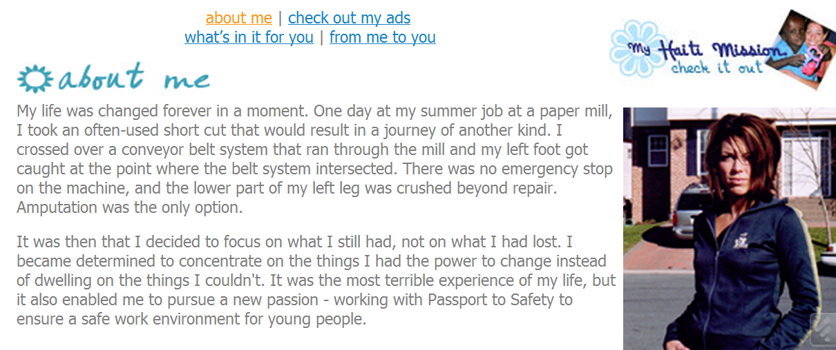

The influence of description on risk perception
www.passporttosafety.com
www.mysafework.com

Slide 42
Counteracting Delayed And Rare Outcomes By Through Immediate Feedback
A study by Zohar (1980) looked at increasing use of ear protectors through information feedback. Workers were given hearing tests before and at the end of their shifts. Hearing levels were found to be poorer at the end of the shift among workers not using ear plugs. This information was fed back to individual workers. Over a period of five months ear plug usage in the department increased to 85-90%.
In a control group workers were given lectures on hearing conservation which were later augmented by disciplinary threats. No more than 10% of the workers in the control group wore earplugs over the five month period.

Slide 43
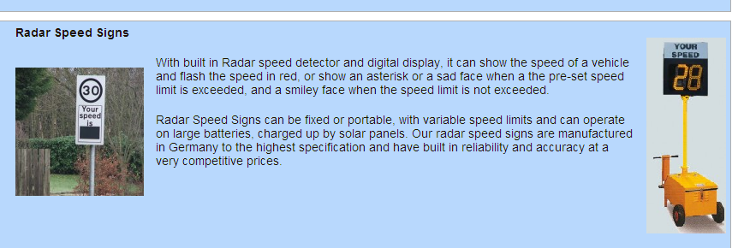

Counteracting Delayed and Rare Outcomes: Immediate Feedback
UK has signs that give you a smiley or frowning face depending on whether you’re speeding

Slide 44
RELATIONSHIPS
Reciprocity
A caring workplace:
  Mearns study*: employer investment in health associated with better safety climate, behavior
Good teamwork associated with better safety and patient outcomes in hospitals
Social proof/Social norms
Recognition
*Investment in workforce health: Exploring the implications for workforce safety climate and commitment Accident Analysis & Prevention
Volume 42, Issue 5, September 2010, Pages 1445-1454

Slide 45
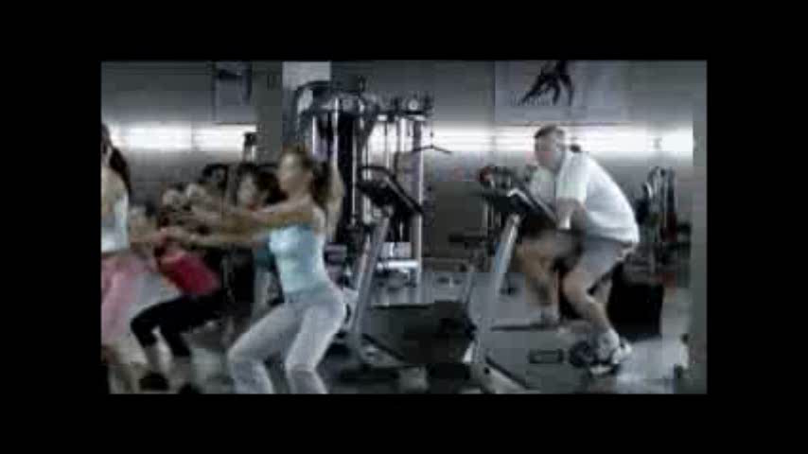

Slide 46

Shame 'boosts hand-washing rate'
The message "Is the person next to you washing with soap?" boosted rates of hand-washing with soap by 11% in women and 12% in men.
The researchers suggested people were most sensitive to the idea that others were watching their behavior: "What other people think - what is deemed to be acceptable behavior - is probably a key determinant in shaping behavior.

Slide 47




Social Norms Marketing campaigns
http://www.mostofus.org/index.php

Slide 48
RELATIONSHIPS with Supervisors
Studies point to importance of supervisor relationships in safety behavior, climate
Relations Among Occupational Hazards, Attitudes, and Safety Performance
Michael T. Ford and Lois E. Tetrick, Journal of Occupational Health Psychology
Volume 16, Issue 1, January 2011, Pages 48-66

Slide 49
Zohar
Supervisor-based safety
Safety exchanges: daily messages
The route through which management influences safety climate
Effectiveness of supervisors’ communications influenced by visibility of workers
The effect of workers' visibility on effectiveness of intervention programs: Supervisory-based safety interventions.
Luria G, Zohar D, Erev I. J. Saf. Res. 2008; 39(3): 273-80.

Slide 50
Commitment and ownership
Endowment effect
Foot in the door
The signature effect
The IKEA effect
  Works for programs and procedures as well as furniture*
  *Antonsen, S. , Safety Culture: Theory, Method and Improvement

Slide 51
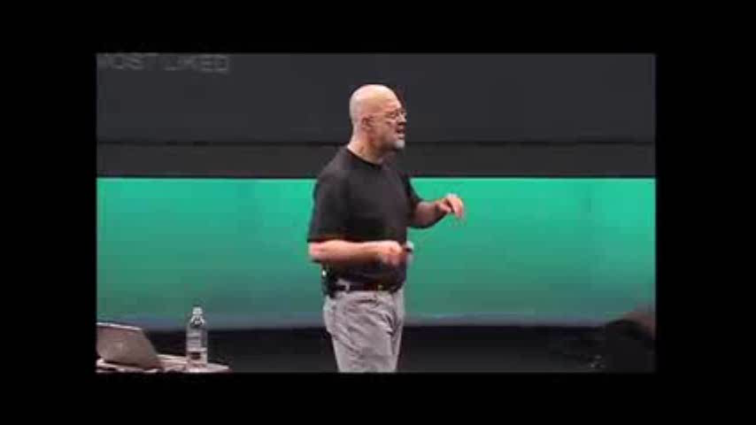

Slide 52
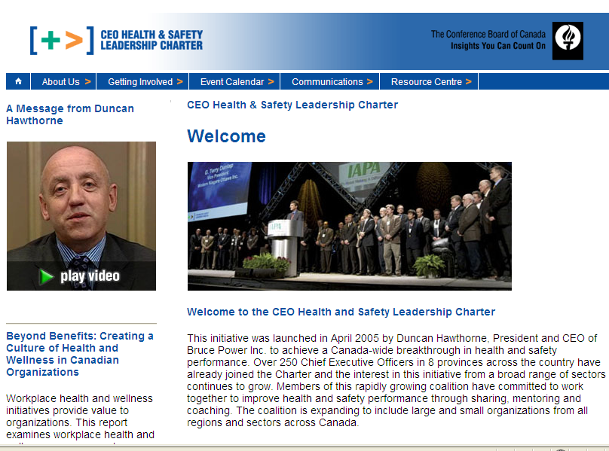
The Safety Pledge: Foot in the Door, Commitment, Social Proof

Slide 53
Dutch study* of successful and not so successful interventions
Necessary but not sufficient for success:
  Shop Floor Training
  Management systems
  Promotion and publicity
*Hale, Guldenmund, van Loenhout, Oh, Safety Science 48 (2010) 1026–1035

Slide 54
Dutch study* of successful and not so successful interventions
Factors that discriminated between successful and not so successful:
  Feedback, learning and dialogue
  Management training
  Relationships/communication between shop floor and line
  Creativity and energy: a critical mass of numerous initiatives
    Commitment of senior management
    Enthusiasm of safety co-ordinator
*Hale, Guldenmund, van Loenhout, Oh, Safety Science 48 (2010) 1026–1035

Slide 55
Summing Up
Assess Your Organization’s Safety Culture
  Maturity stage
  Underlying culture
Decide on priorities for influencing
Select motivators and influencers that are appropriate to your culture and stage
Evaluate and improve

Slide 56

Discussion and Questions
Thank you!
omalik@ecoh.ca
mlevitsky@ecoh.ca
www.ecoh.ca www.healthandsafetycatalyst.com
@safetycatalyst

